Slide 1

VoiceFly : Voice Bluetooth Controlled Drone
Debjit Biswas(16900321022), Jyotiraditya Roy(16900321028), Suprita Bag(16900321025), Supriyo Mondal(16900321024), Arpan Kumar(16900721019)
Guide – Prof. Kanishka Majumder
Associate Professor
Department Of Electronics & Communication Engineering
Academy Of Technology
MAKAUT

Slide 2

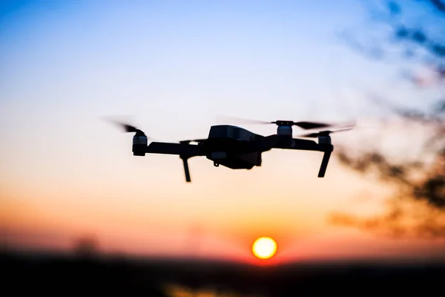
CONTENTS
1. Introductions
2. Objective
3. Working Principle
4. Application
5. Components
6. Advantages
7. Disadvantages
8. Conclusion

Slide 3

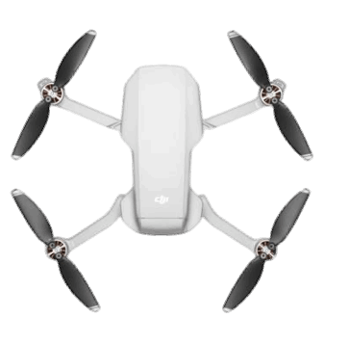
Introduction
Drones, also known as unmanned aerial vehicles (UAVs), are versatile flying devices that are remotely operated and equipped with various technologies for a wide range of applications across industries and sectors.

Slide 4

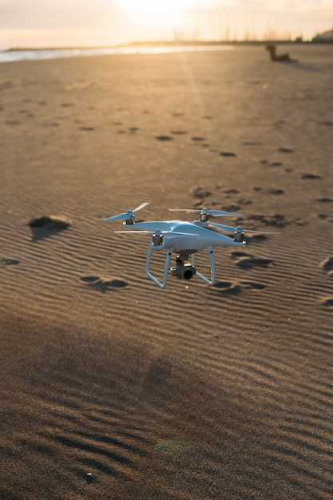
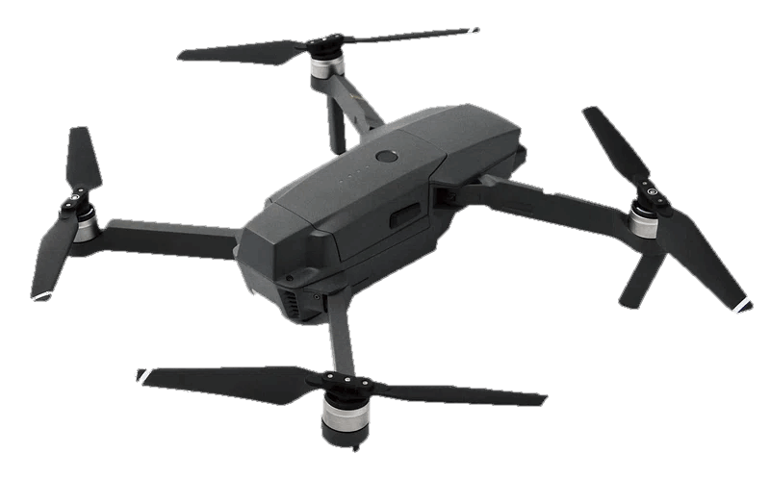
Objective
To develop and operate a drone controlled via Bluetooth technology, enabling short-range wireless communication for basic navigation and functionality, with a focus on ease of use, low cost, and real-time control.

Slide 5

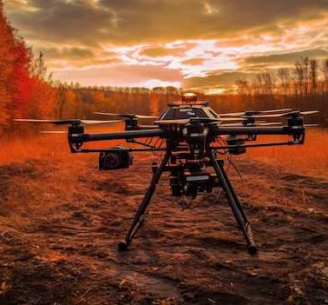
COMPONENTS OF DRONES
01
Arduino Uno
02
HC-05 Bluetooth Module
03
MPU6050 Gyroscope
04
4 x Brushless Motors
DRONE
05
4 x ESCs(Speed Controller)
06
11.1 V 2200mAh Li-Po Battery

Slide 6

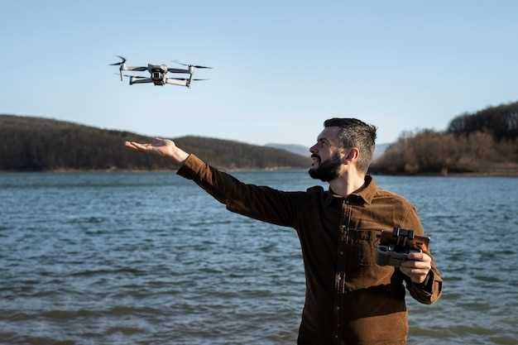
WORKING PRINCIPLE And Videography
VoiceFly is a voice-controlled drone operated via Bluetooth using the HC-05 module and an Arduino Uno. Voice commands like “start,” “stop,” “forward,” “backward,” “speed up,” and “speed down” are given through a mobile app, converted into Bluetooth signals, and received by the HC-05. The Arduino processes these commands to control the ESCs and BLDC motors, enabling precise drone movement while maintaining balance with the help of a gyroscope sensor.

Slide 7
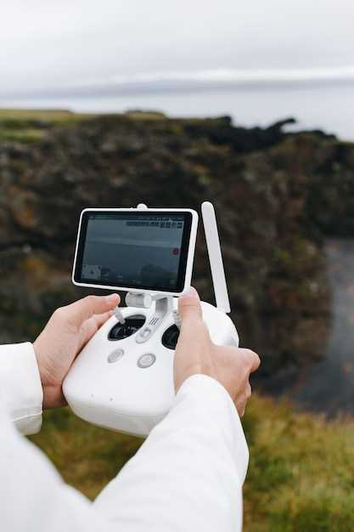
Applications Of Our Drone
Surveillance – Enables voice-controlled monitoring of sensitive or hard-to-reach areas.
Agriculture – Assists in crop inspection and field monitoring through hands-free operation.
Disaster Response – Helps in locating victims or assessing damage during emergencies.
Educational Use – Serves as a learning tool for robotics, embedded systems, and voice technology.

Slide 8

Advantages
1. Easy to Build and Program: Arduino platform is beginner-friendly, with a wide range of community support and open-source libraries.
2. Ideal for Learning and Prototyping: Great for understanding basic drone mechanics, control systems, and embedded programming.

Slide 9
01
Interference: Bluetooth communication is prone to signal interference from other wireless devices or obstacles, which may affect drone responsiveness.
Disadvantages
02
Latency: There can be a slight delay between giving a voice command and the drone executing it, especially in noisy environments.
03
Range: Bluetooth has a limited operational range (typically around 10 meters), which restricts how far the drone can be controlled.

Slide 10

VoiceFly Bluetooth Voice Control Interface
This is the main control interface of the VoiceFly drone system. It allows users to operate the drone using simple voice commands through Bluetooth connectivity. With a user-friendly design and a prominent microphone button, this screen enables real-time voice input for actions such as Start, Stop, Forward, Backward, Speed Up, and Speed Down. The system ensures hands-free control, enhancing both convenience and flight safety during operation.

Slide 11
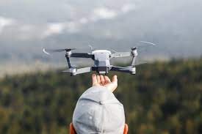
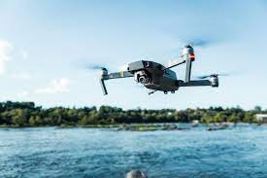
Drone Stabilization
- MPU6050 provides pitch and roll angles.
- PID-based adjustments applied to motor speeds.
- Keeps drone balanced in the air.

Slide 12
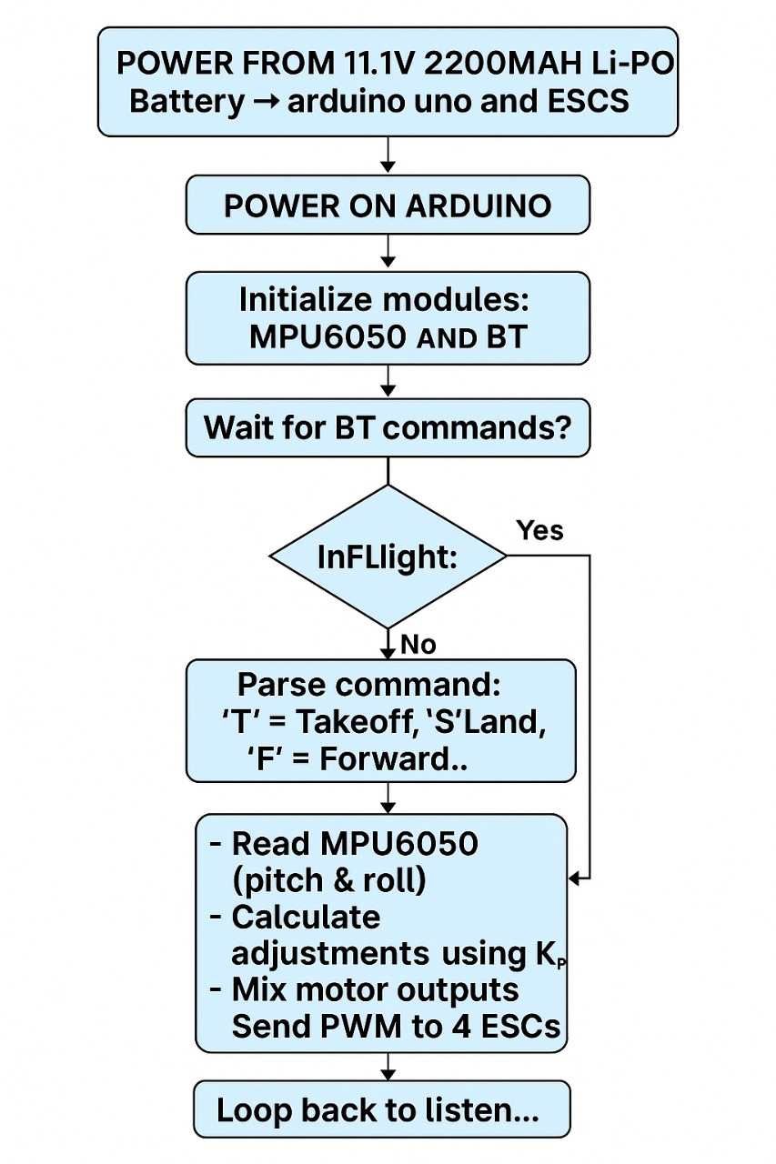
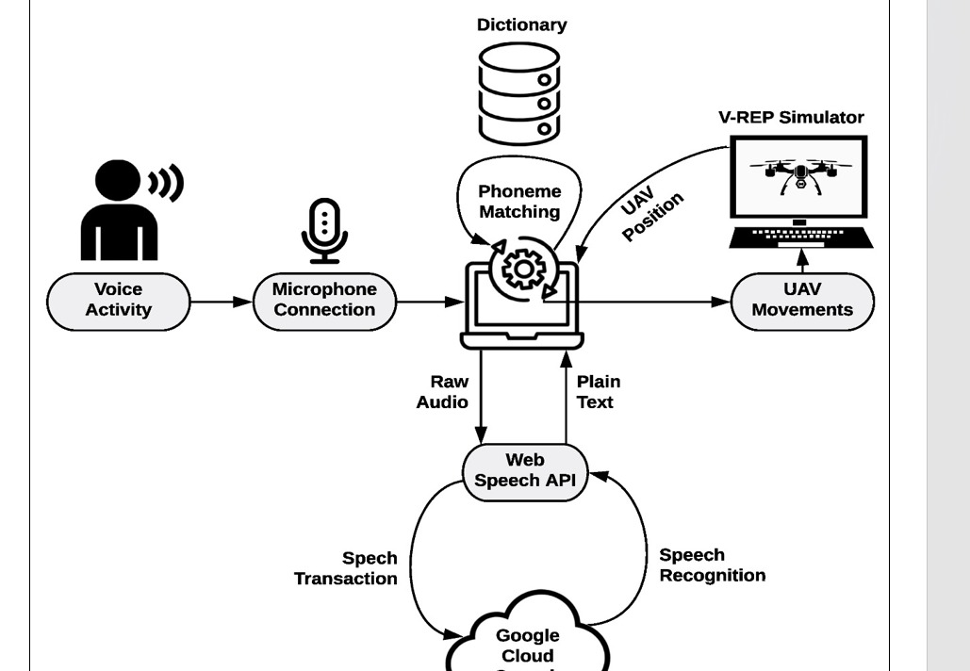
Flow Chart
- Start → Arm ESCs → Wait for Bluetooth Command
- → Read MPU6050 → Adjust Motors → Loop
- → Land/Stop on Command
Future Scope:
GPS and Camera Module: Enable autonomous flight and live video streaming.
Wi-Fi-Based Control: Extend control range beyond Bluetooth limits.

Slide 13
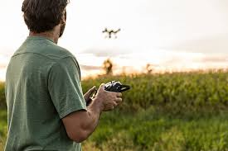
Control Commands
Command | Function
Start | Powers on the drone and prepares it for flight
Stop | Immediately stops the drone and powers down
Forward | Moves the drone forward
Backward | Moves the drone backward
Left | Rotates or shifts the drone to the left
Right | Rotates or shifts the drone to the right
Speed Up | Increases the flying speed
Speed Down | Decreases the flying speed

Slide 14
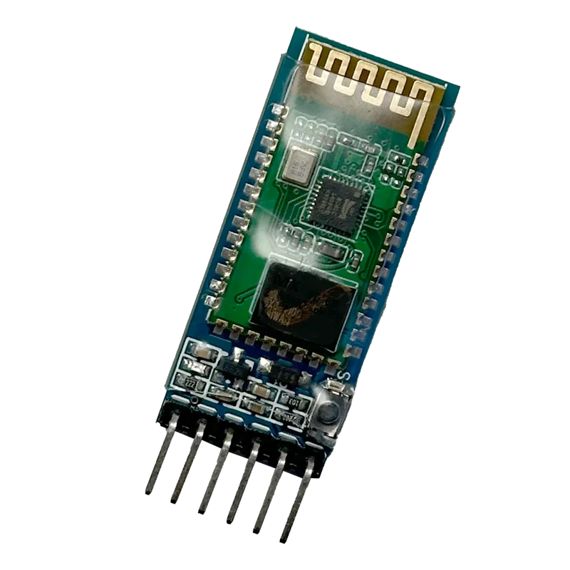
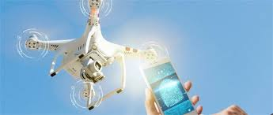
HC-05 Bluetooth Module
- Enables wireless communication with the mobile phone.
- Connected via Software Serial on pins 2 (RX) and 3 (TX).
- Receives control commands from app buttons (e.g., F, B, L, R).

Slide 15
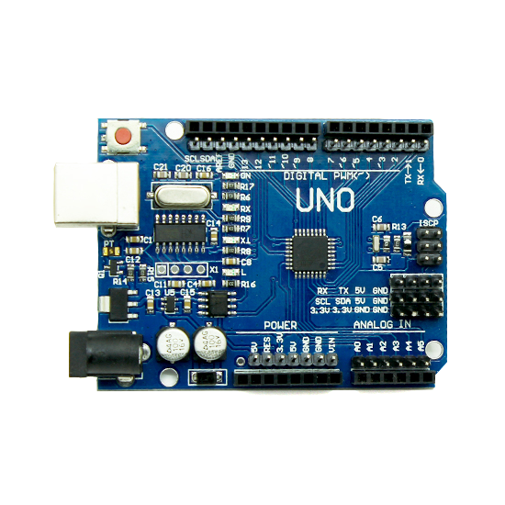
Arduino Uno
- Microcontroller: ATmega328P
- Acts as the brain of the drone
- Controls motor speed via PWM
- Interfaces with MPU6050 and Bluetooth

Slide 16
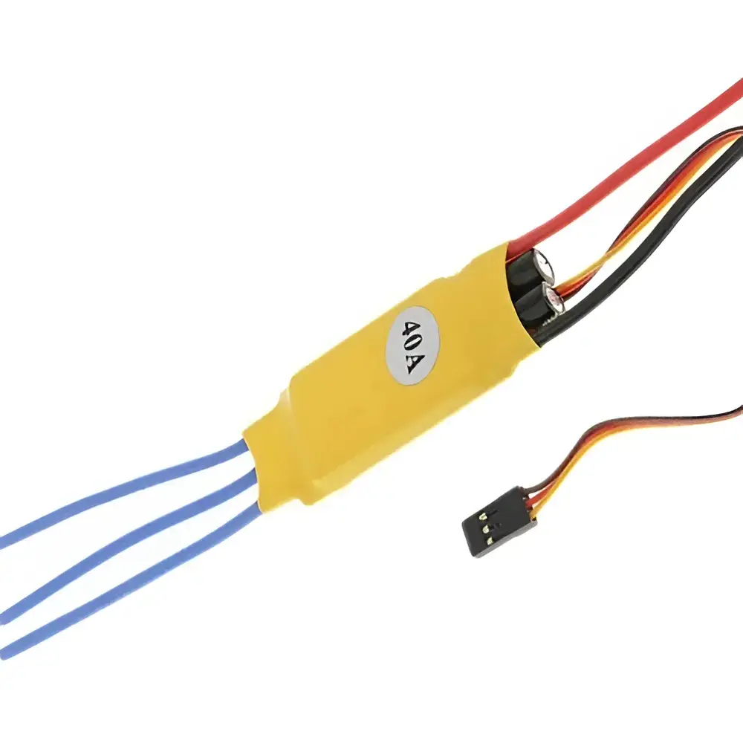
ESCs and Motors
- ESCs control the brushless motors via PWM signals.
- Motors are positioned in an “X” configuration.
- Each motor is connected to a dedicated ESC.

Slide 17


Arduino Code Overview
- Includes setup for ESCs, MPU6050, and Bluetooth.
- loop() reads commands and sensor data.
- Motor speeds adjusted in real-time.

Slide 18
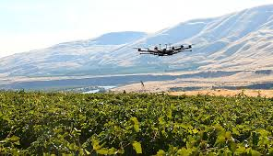
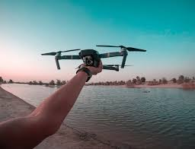
Challenges Faced
- Balancing all 4 motors equally
- Reading and using MPU6050 data correctly
- Tuning stabilization for real-time response
- Reliable Bluetooth command reception

Slide 19

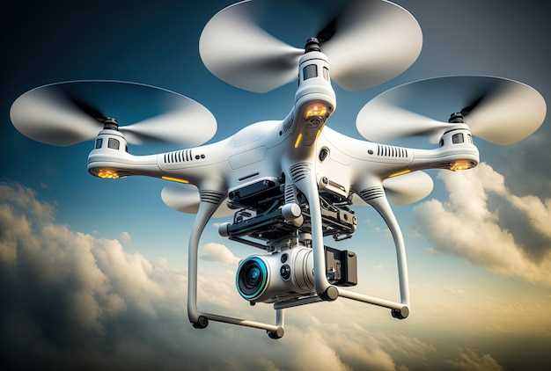
Conclusion
Our Bluetooth- Voice controlled drone, built using Arduino and a gyro sensor, demonstrates a simple yet functional model of modern UAV technology. It offers an affordable, educational platform for learning wireless control, sensor integration, and basic flight stabilization. While it has limitations in range and automation, it serves as a strong foundation for future improvements and more advanced drone applications..

Slide 20
Thank You

